Slide 1

Jacob Dyer, Anthony Bonadies, Tyler Green

Slide 2
The Agenda for Today’s Presentation
What is Jam Basket?
Our initial scope.
What is Jam Basket today?
Includes a demo!
The Post-Mortem
Questions and Answers

Slide 3
What is a Jam?

Slide 4
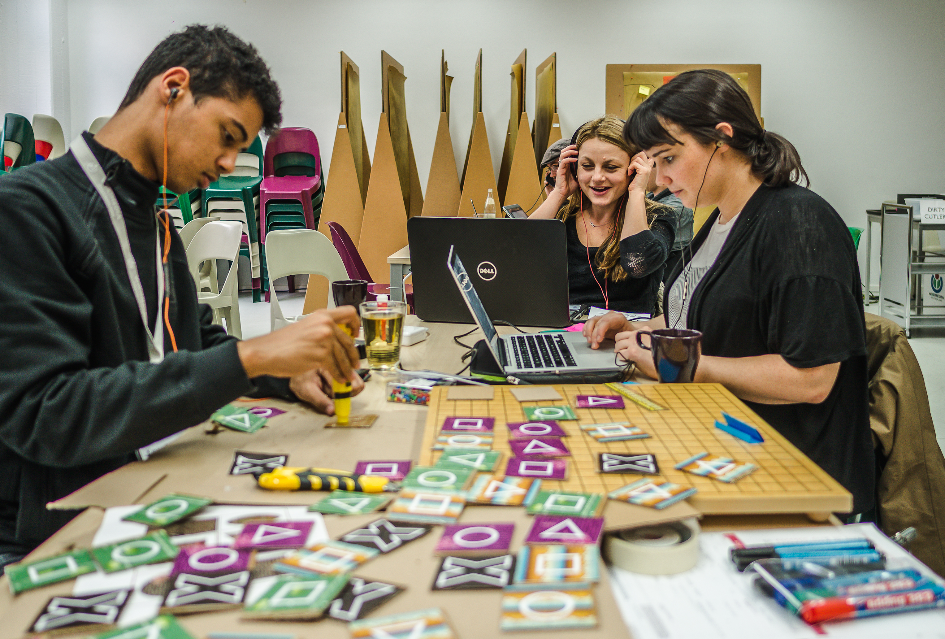
Game Jam (n.):
A competition among video game developers to make a themed video game in a short period of time.

Slide 5

How have others addressed this phenomenon?

Slide 6
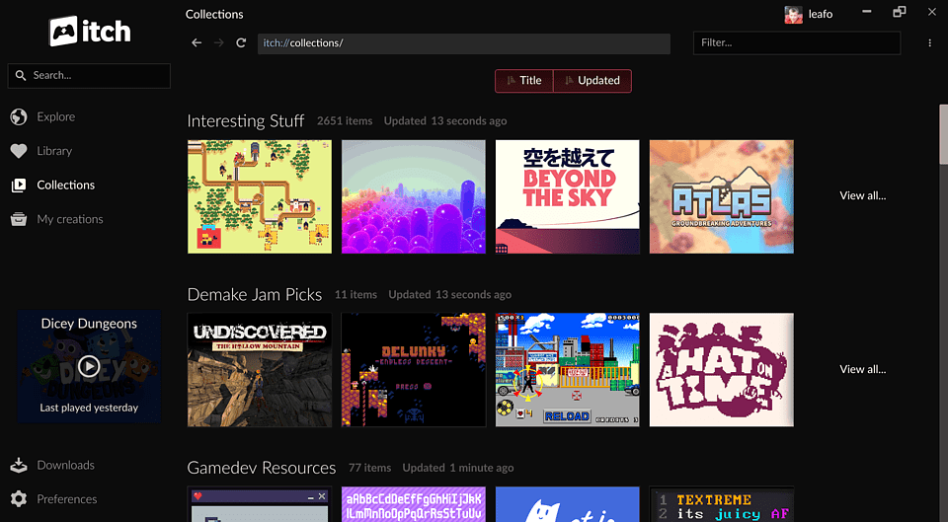

Our Competition: itch.io
itch.io is predominantly a games marketplace where users create and sell indie games. Itch.io also has the infrastructure to facilitate other peoples’ Game Jams.

Slide 7
What does Jam Basket do better?

Slide 8
Jam Basket is a web application which seeks to provide a two-in-one Jam Platform and Project Portfolio service.

Slide 9
What was our initial vision for Jam Basket?

Slide 10
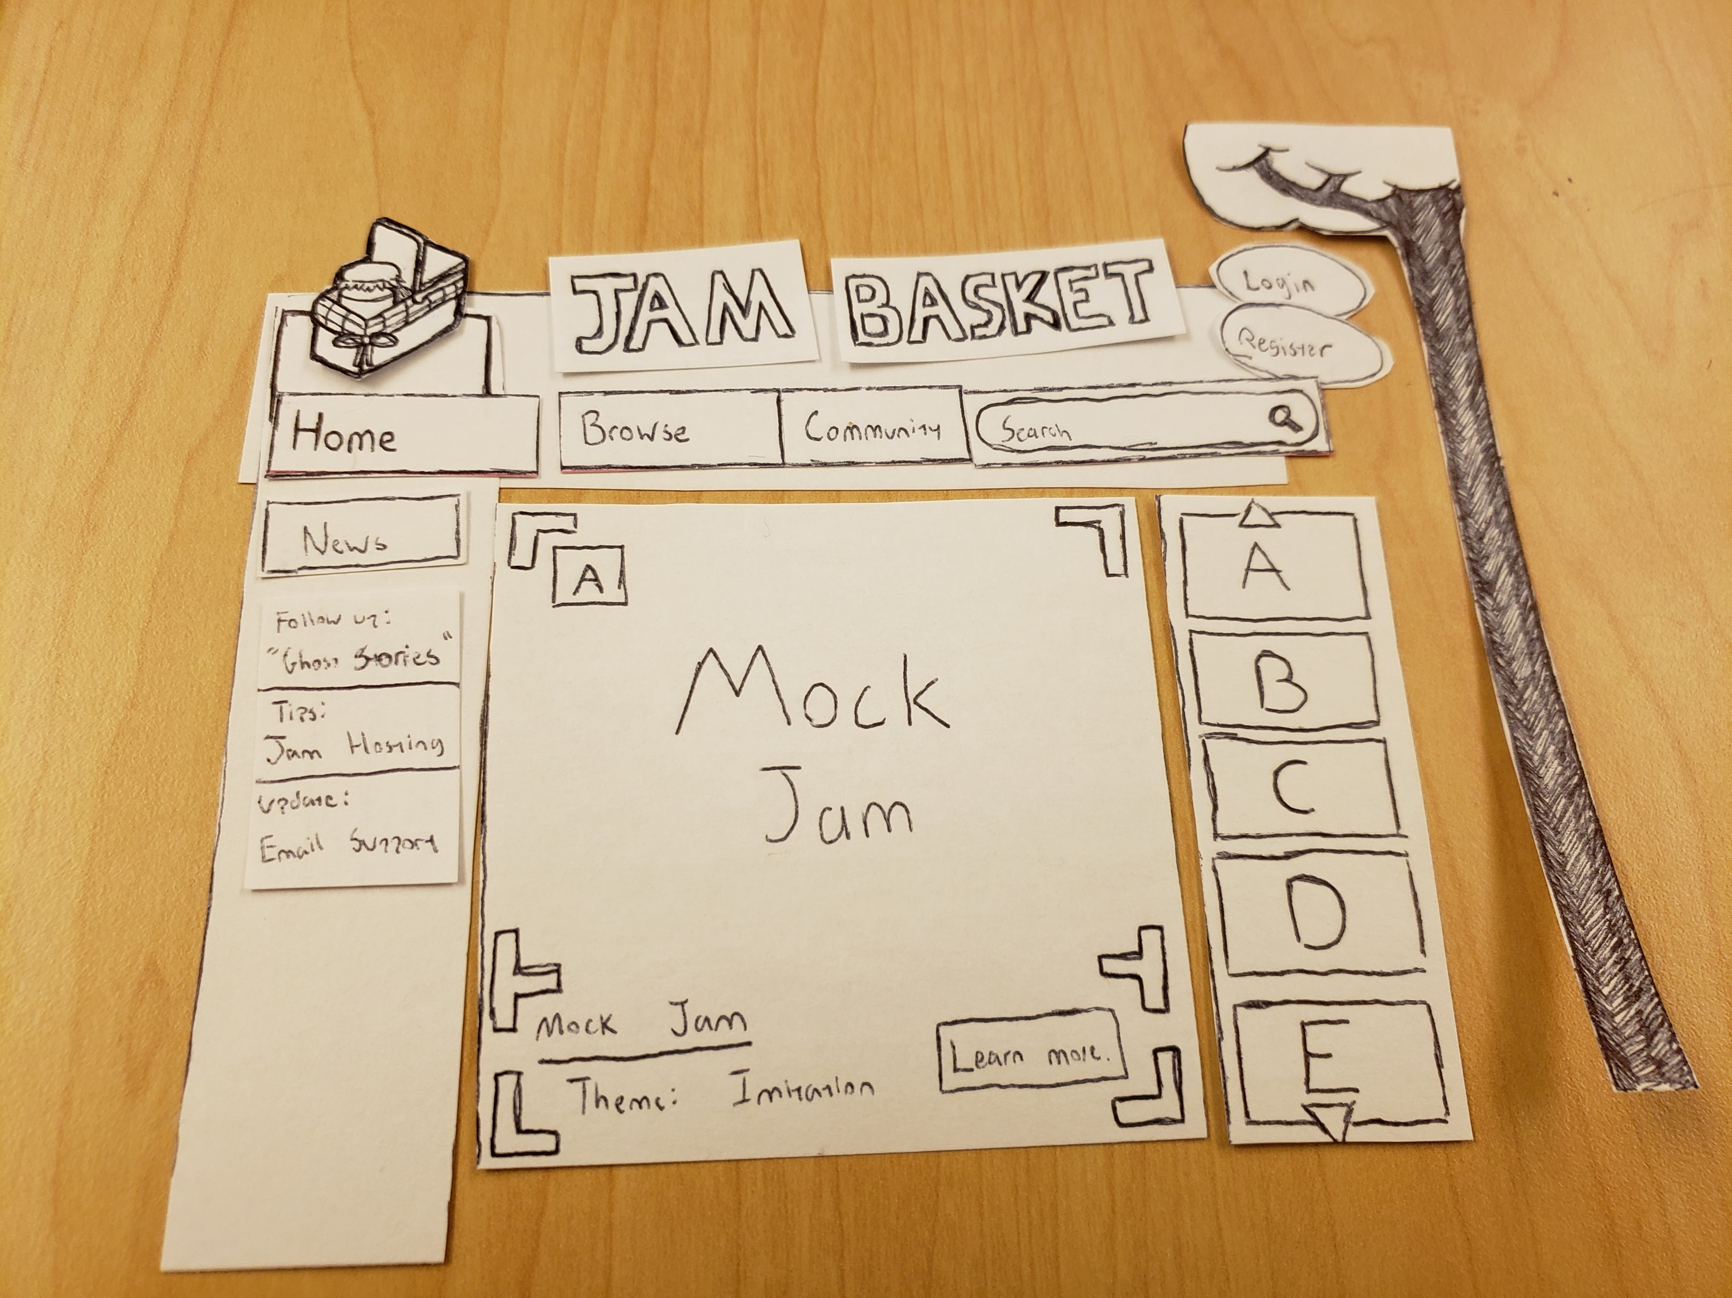

Slide 11
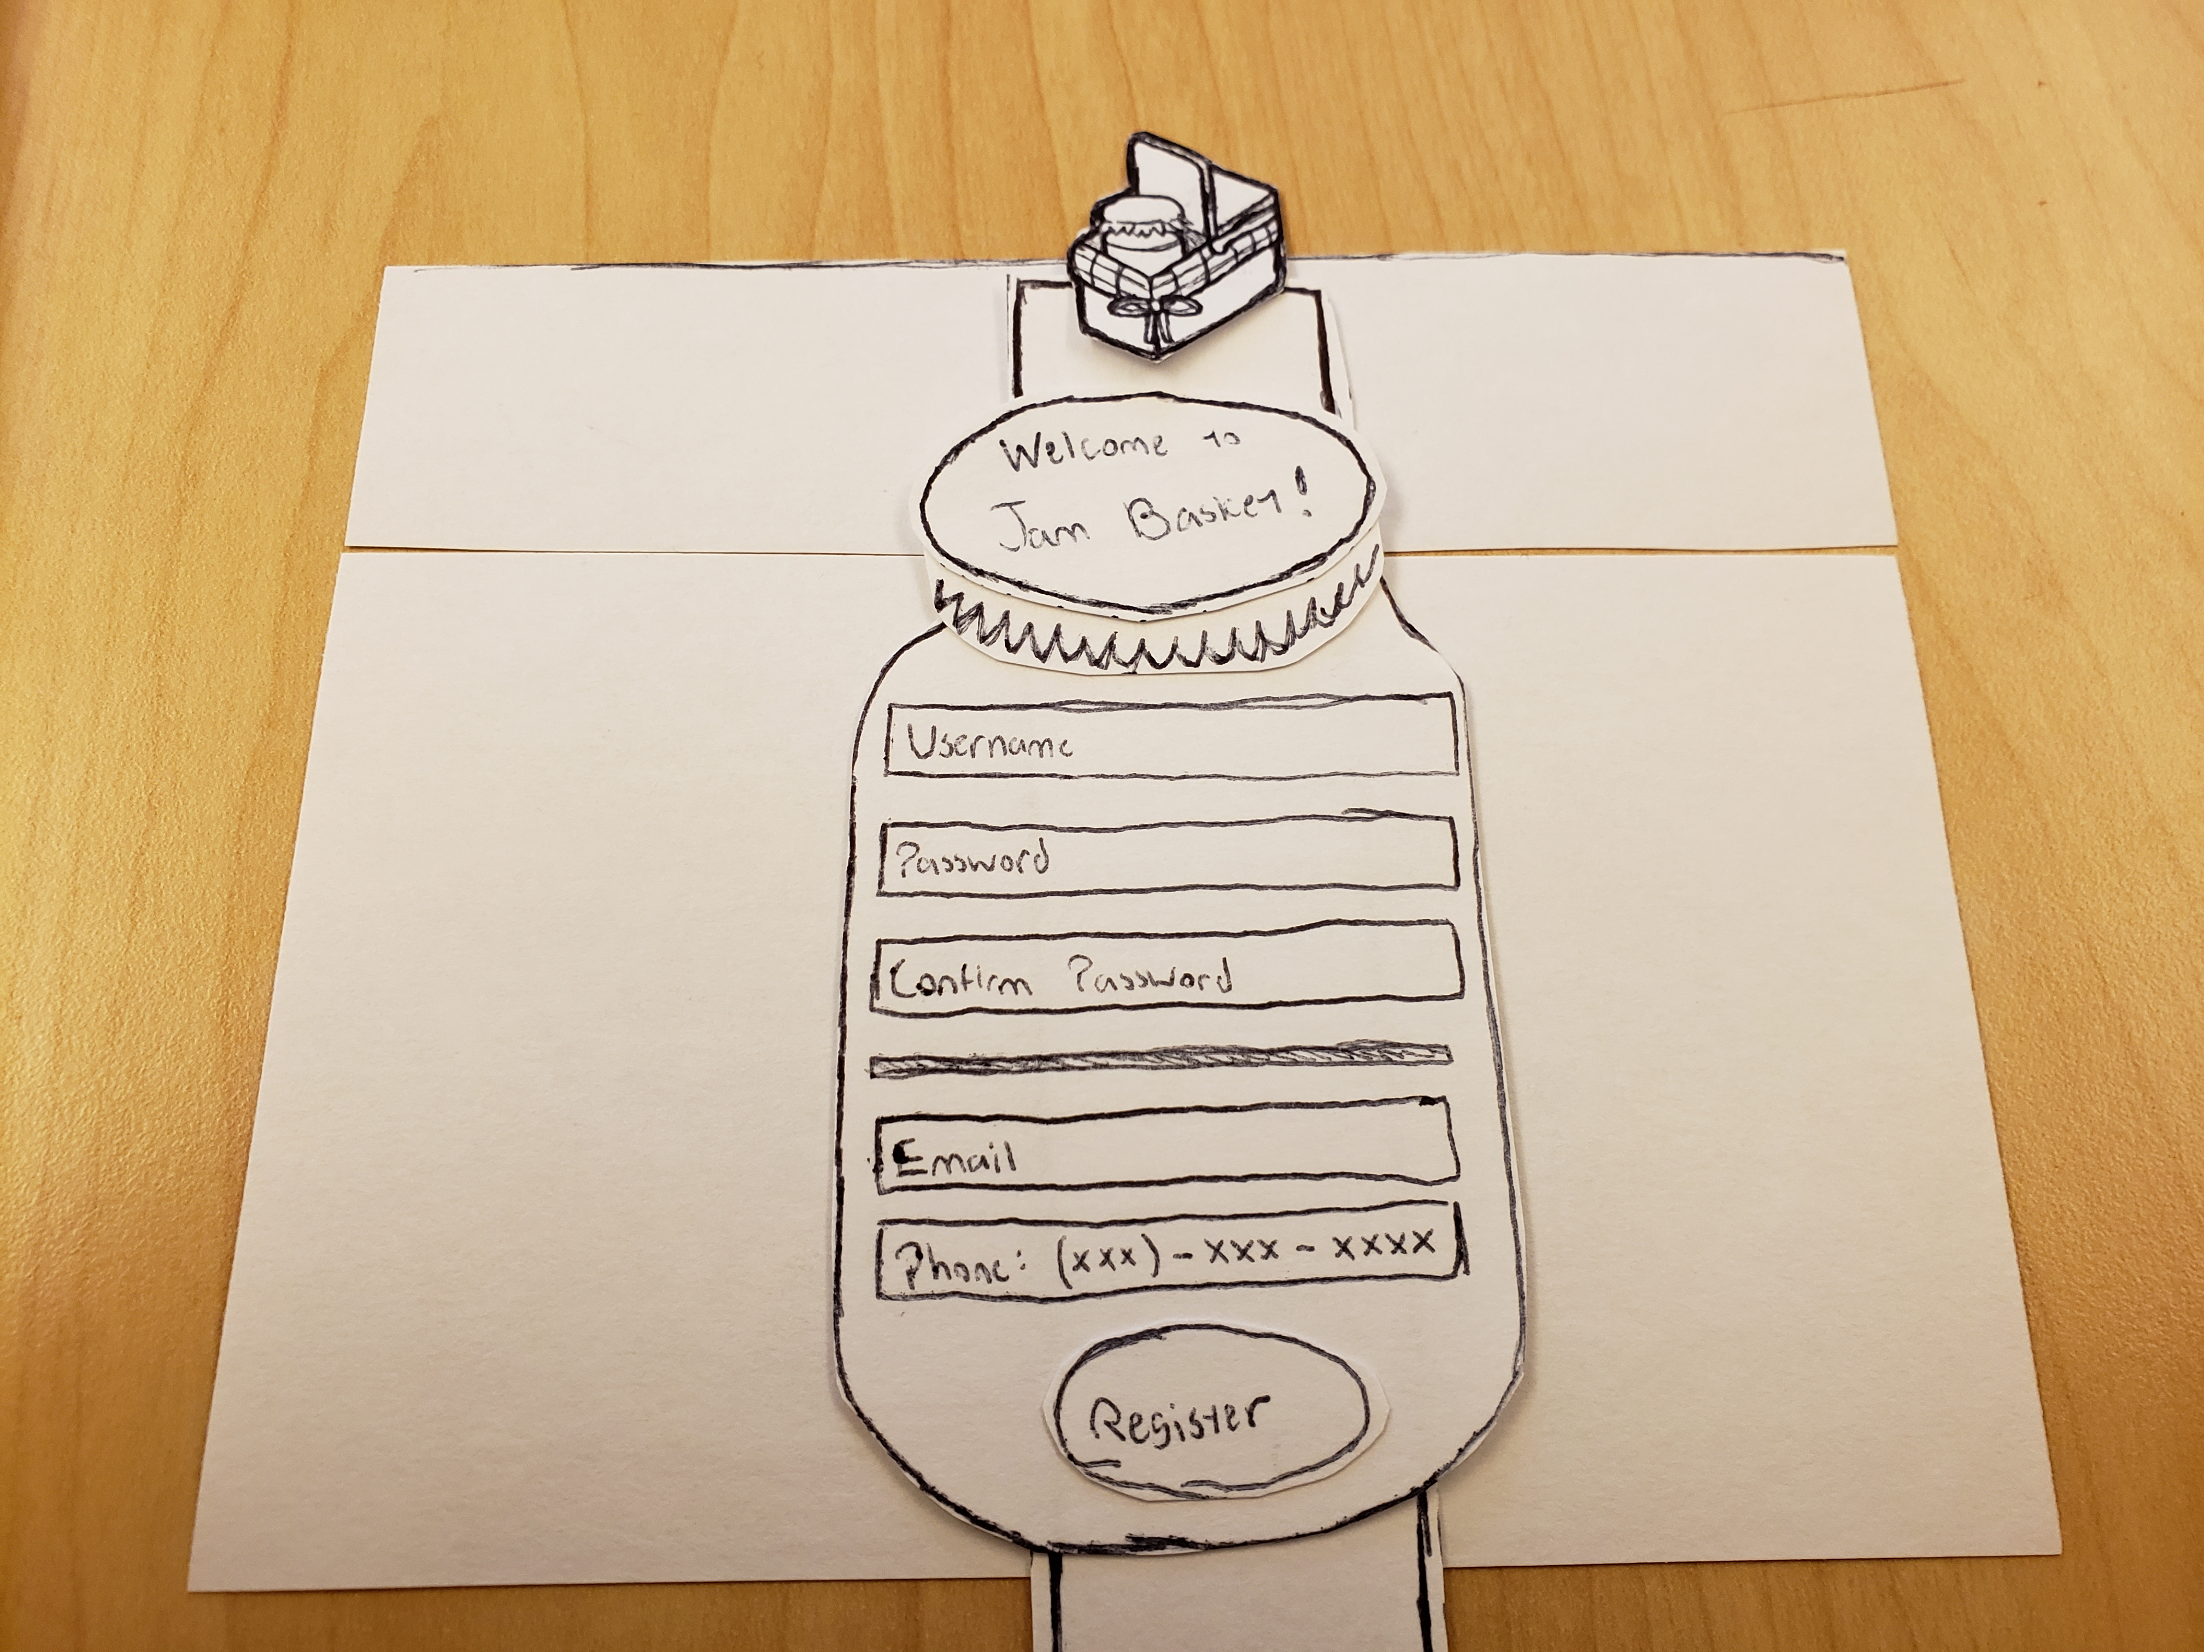

Slide 12
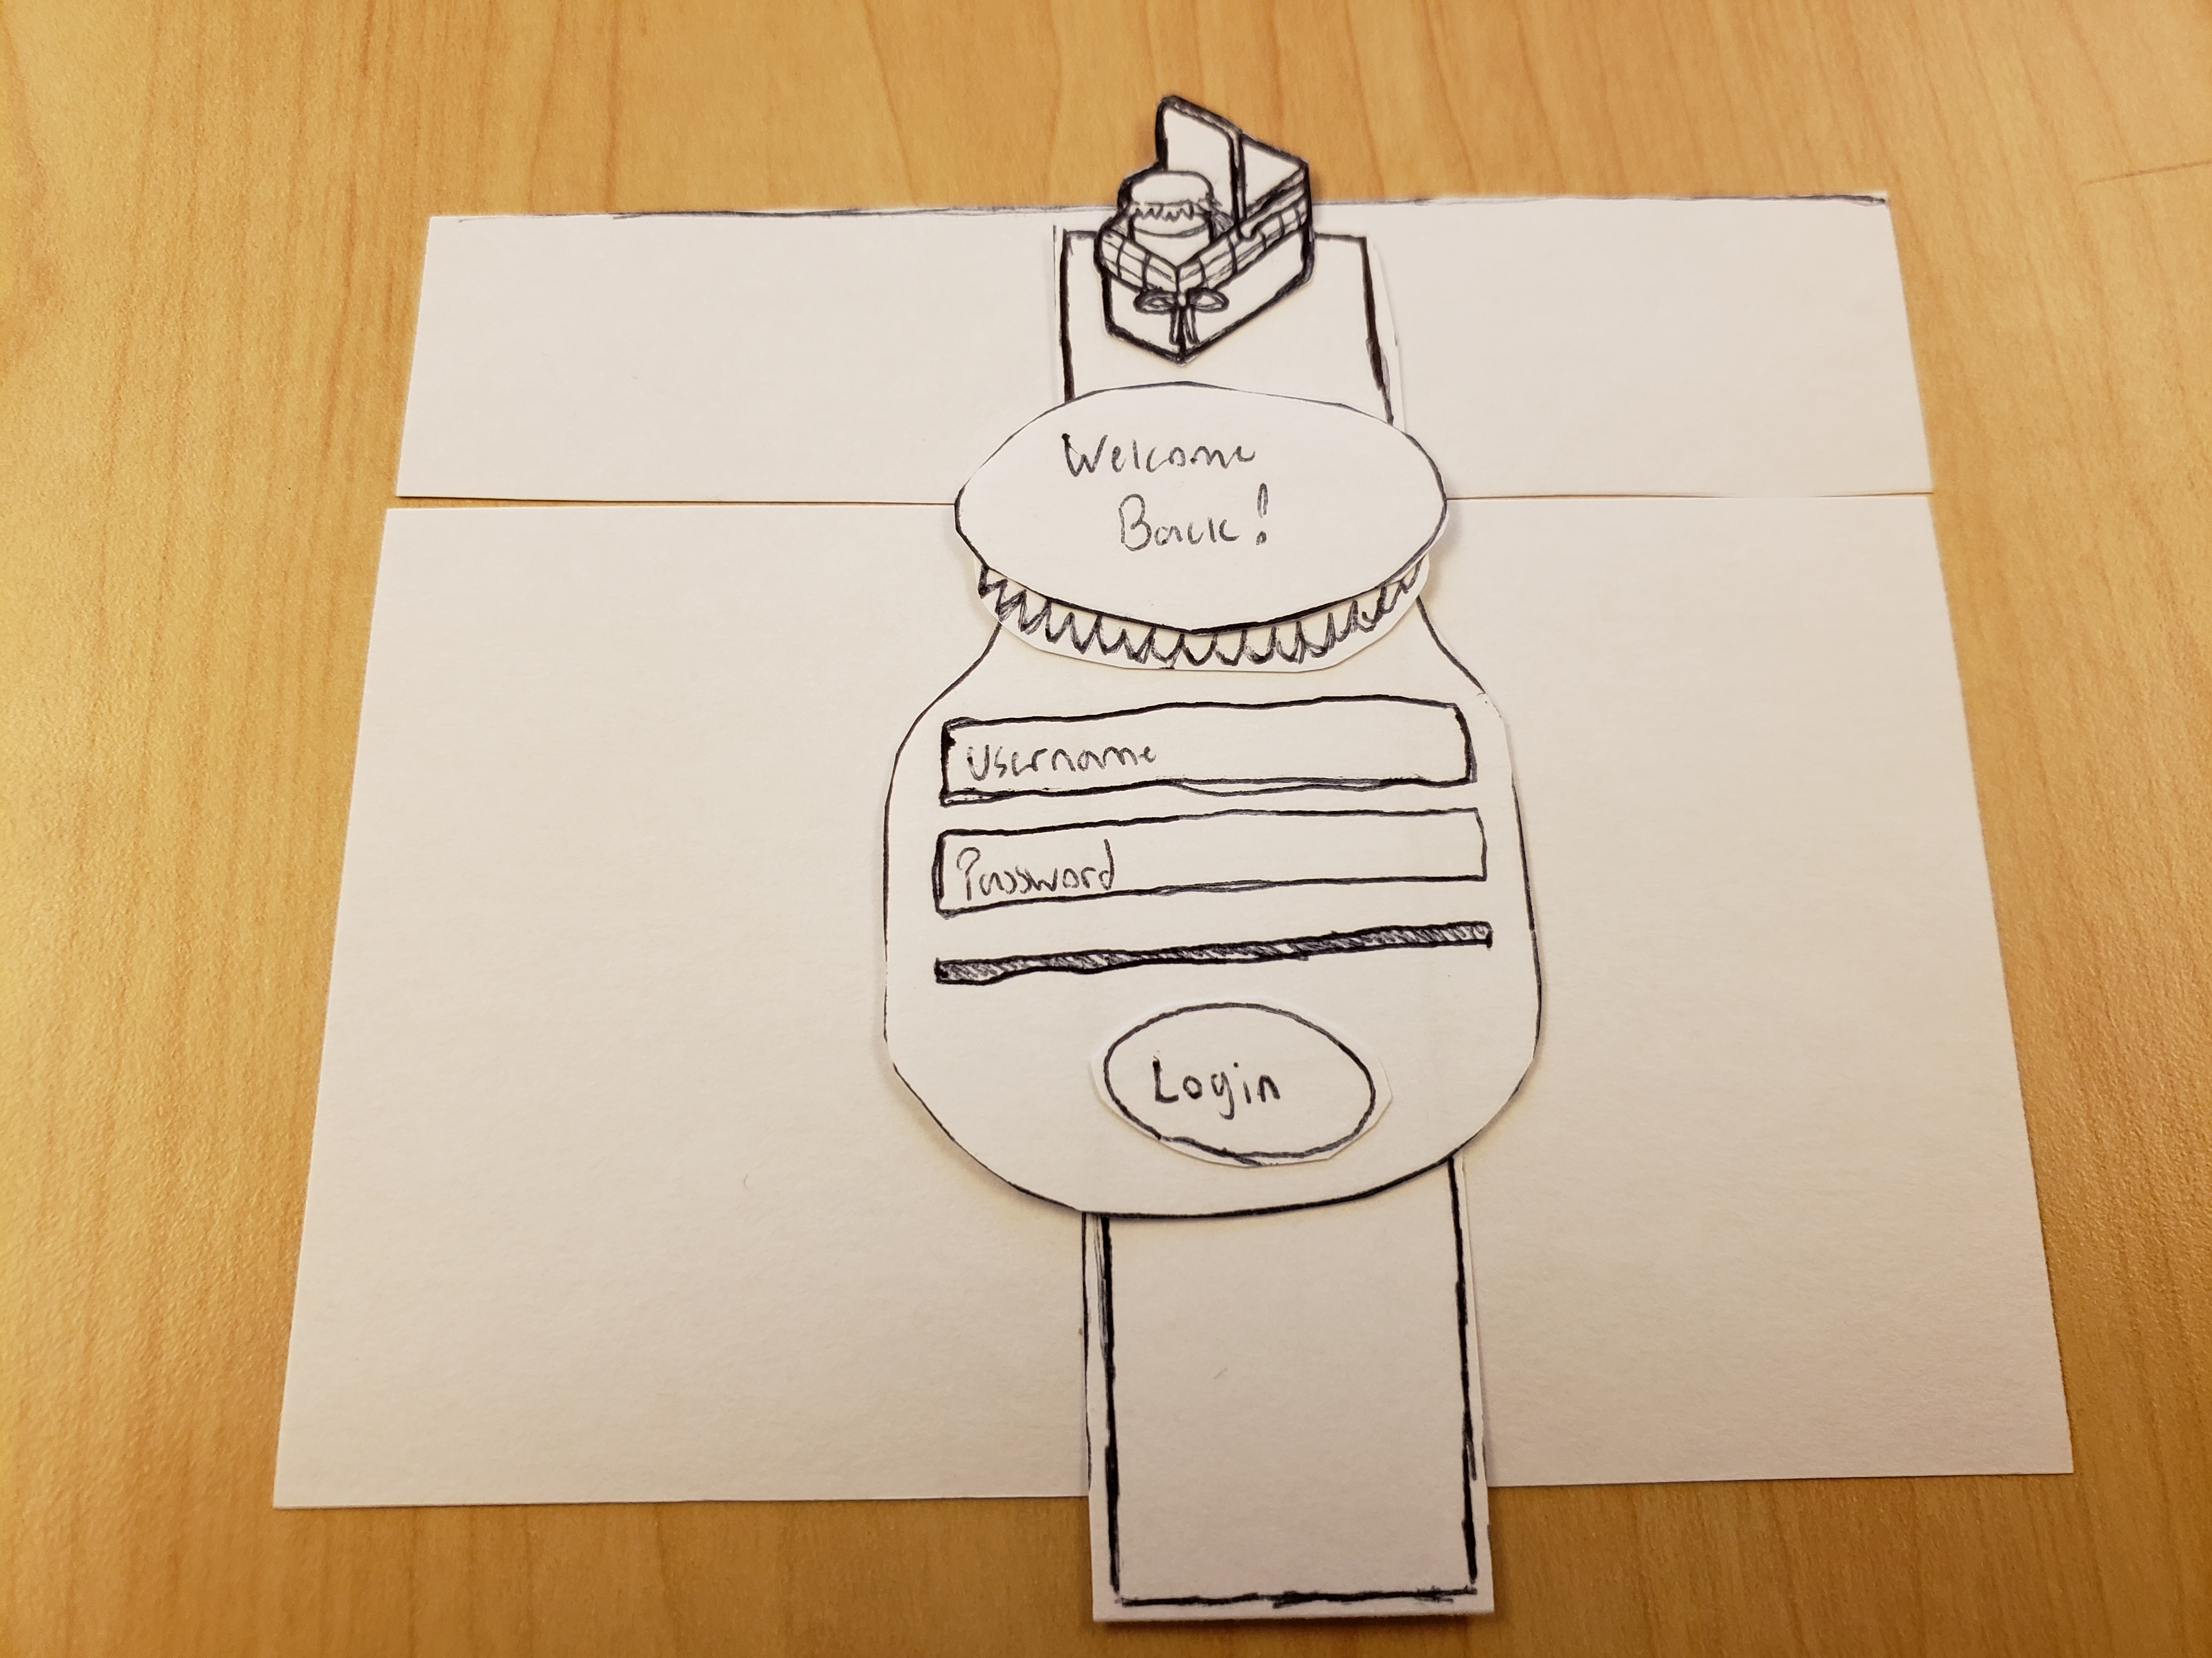

Slide 13
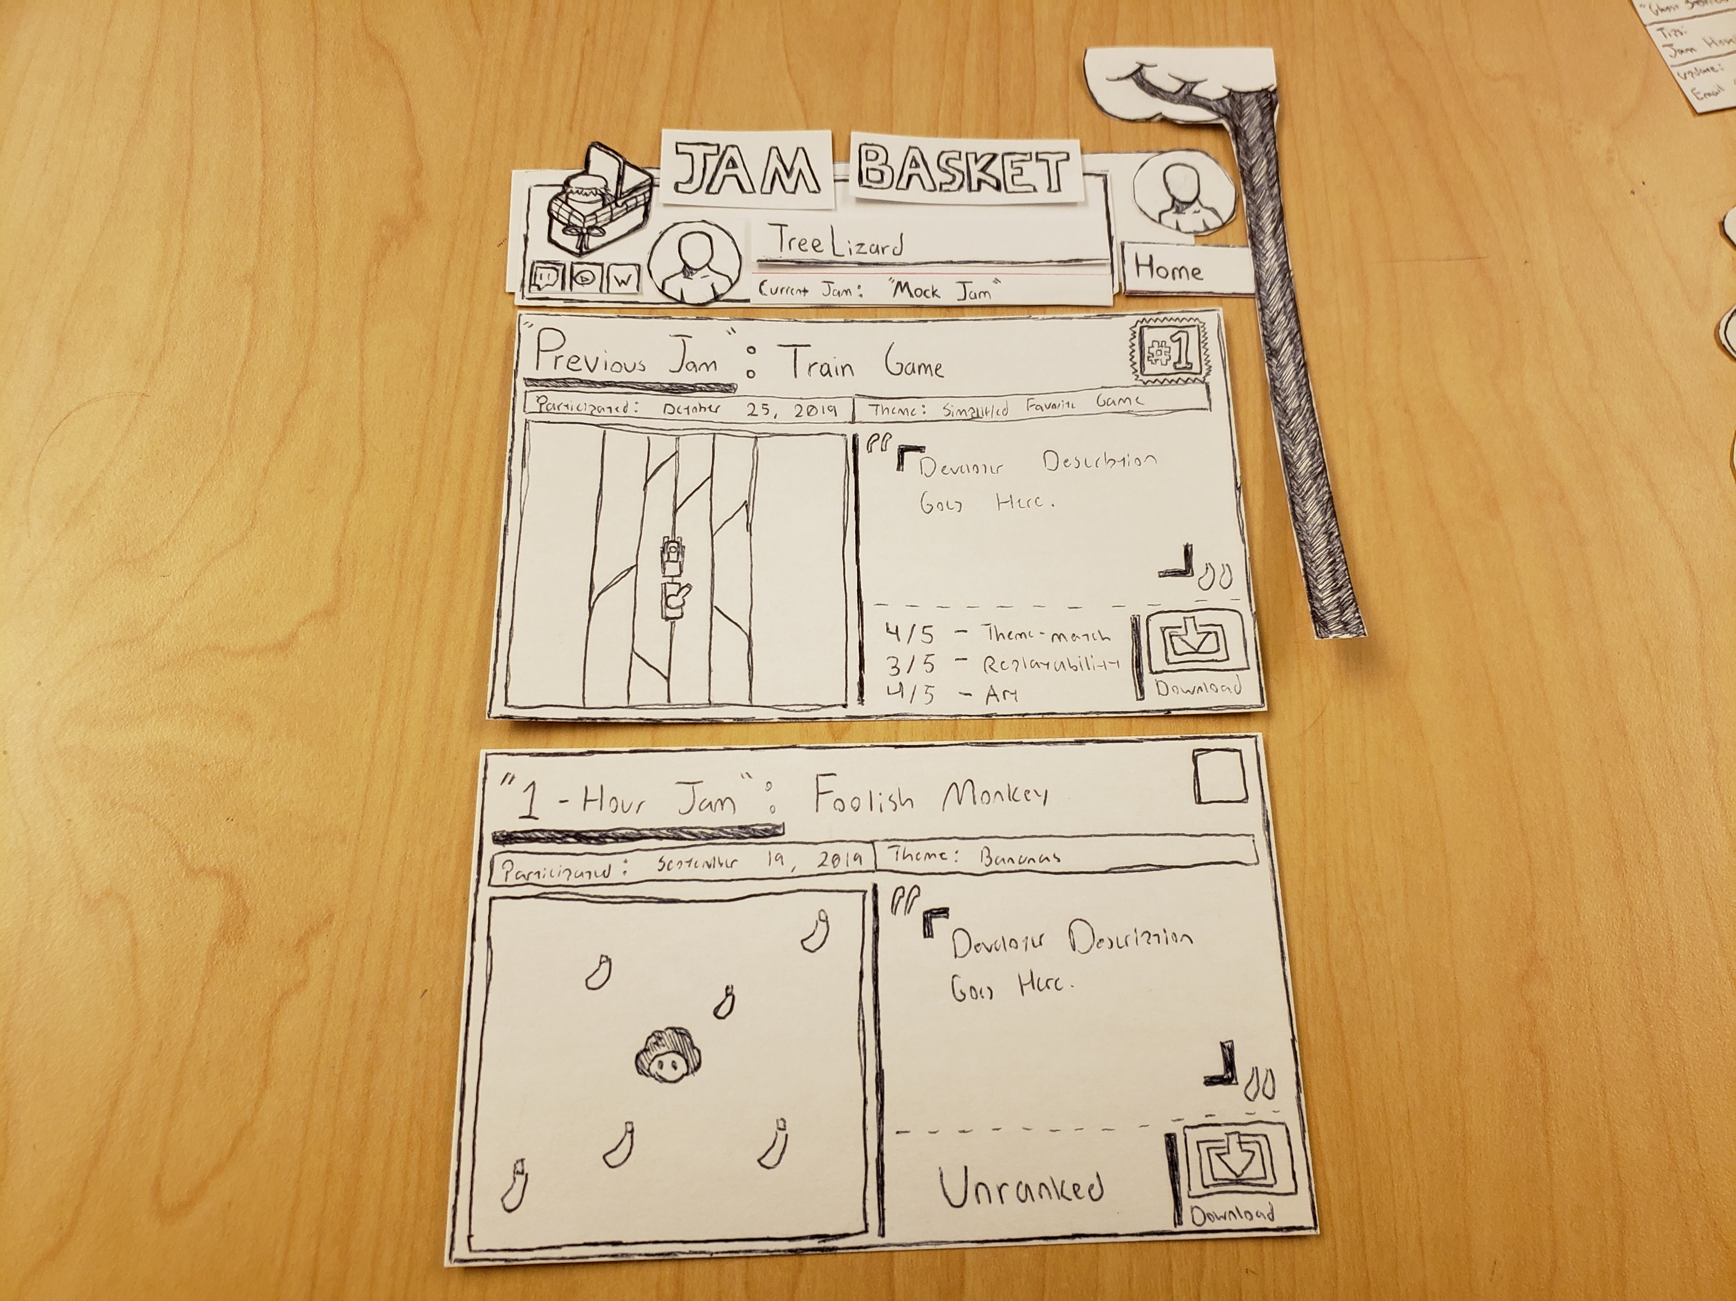

Slide 14
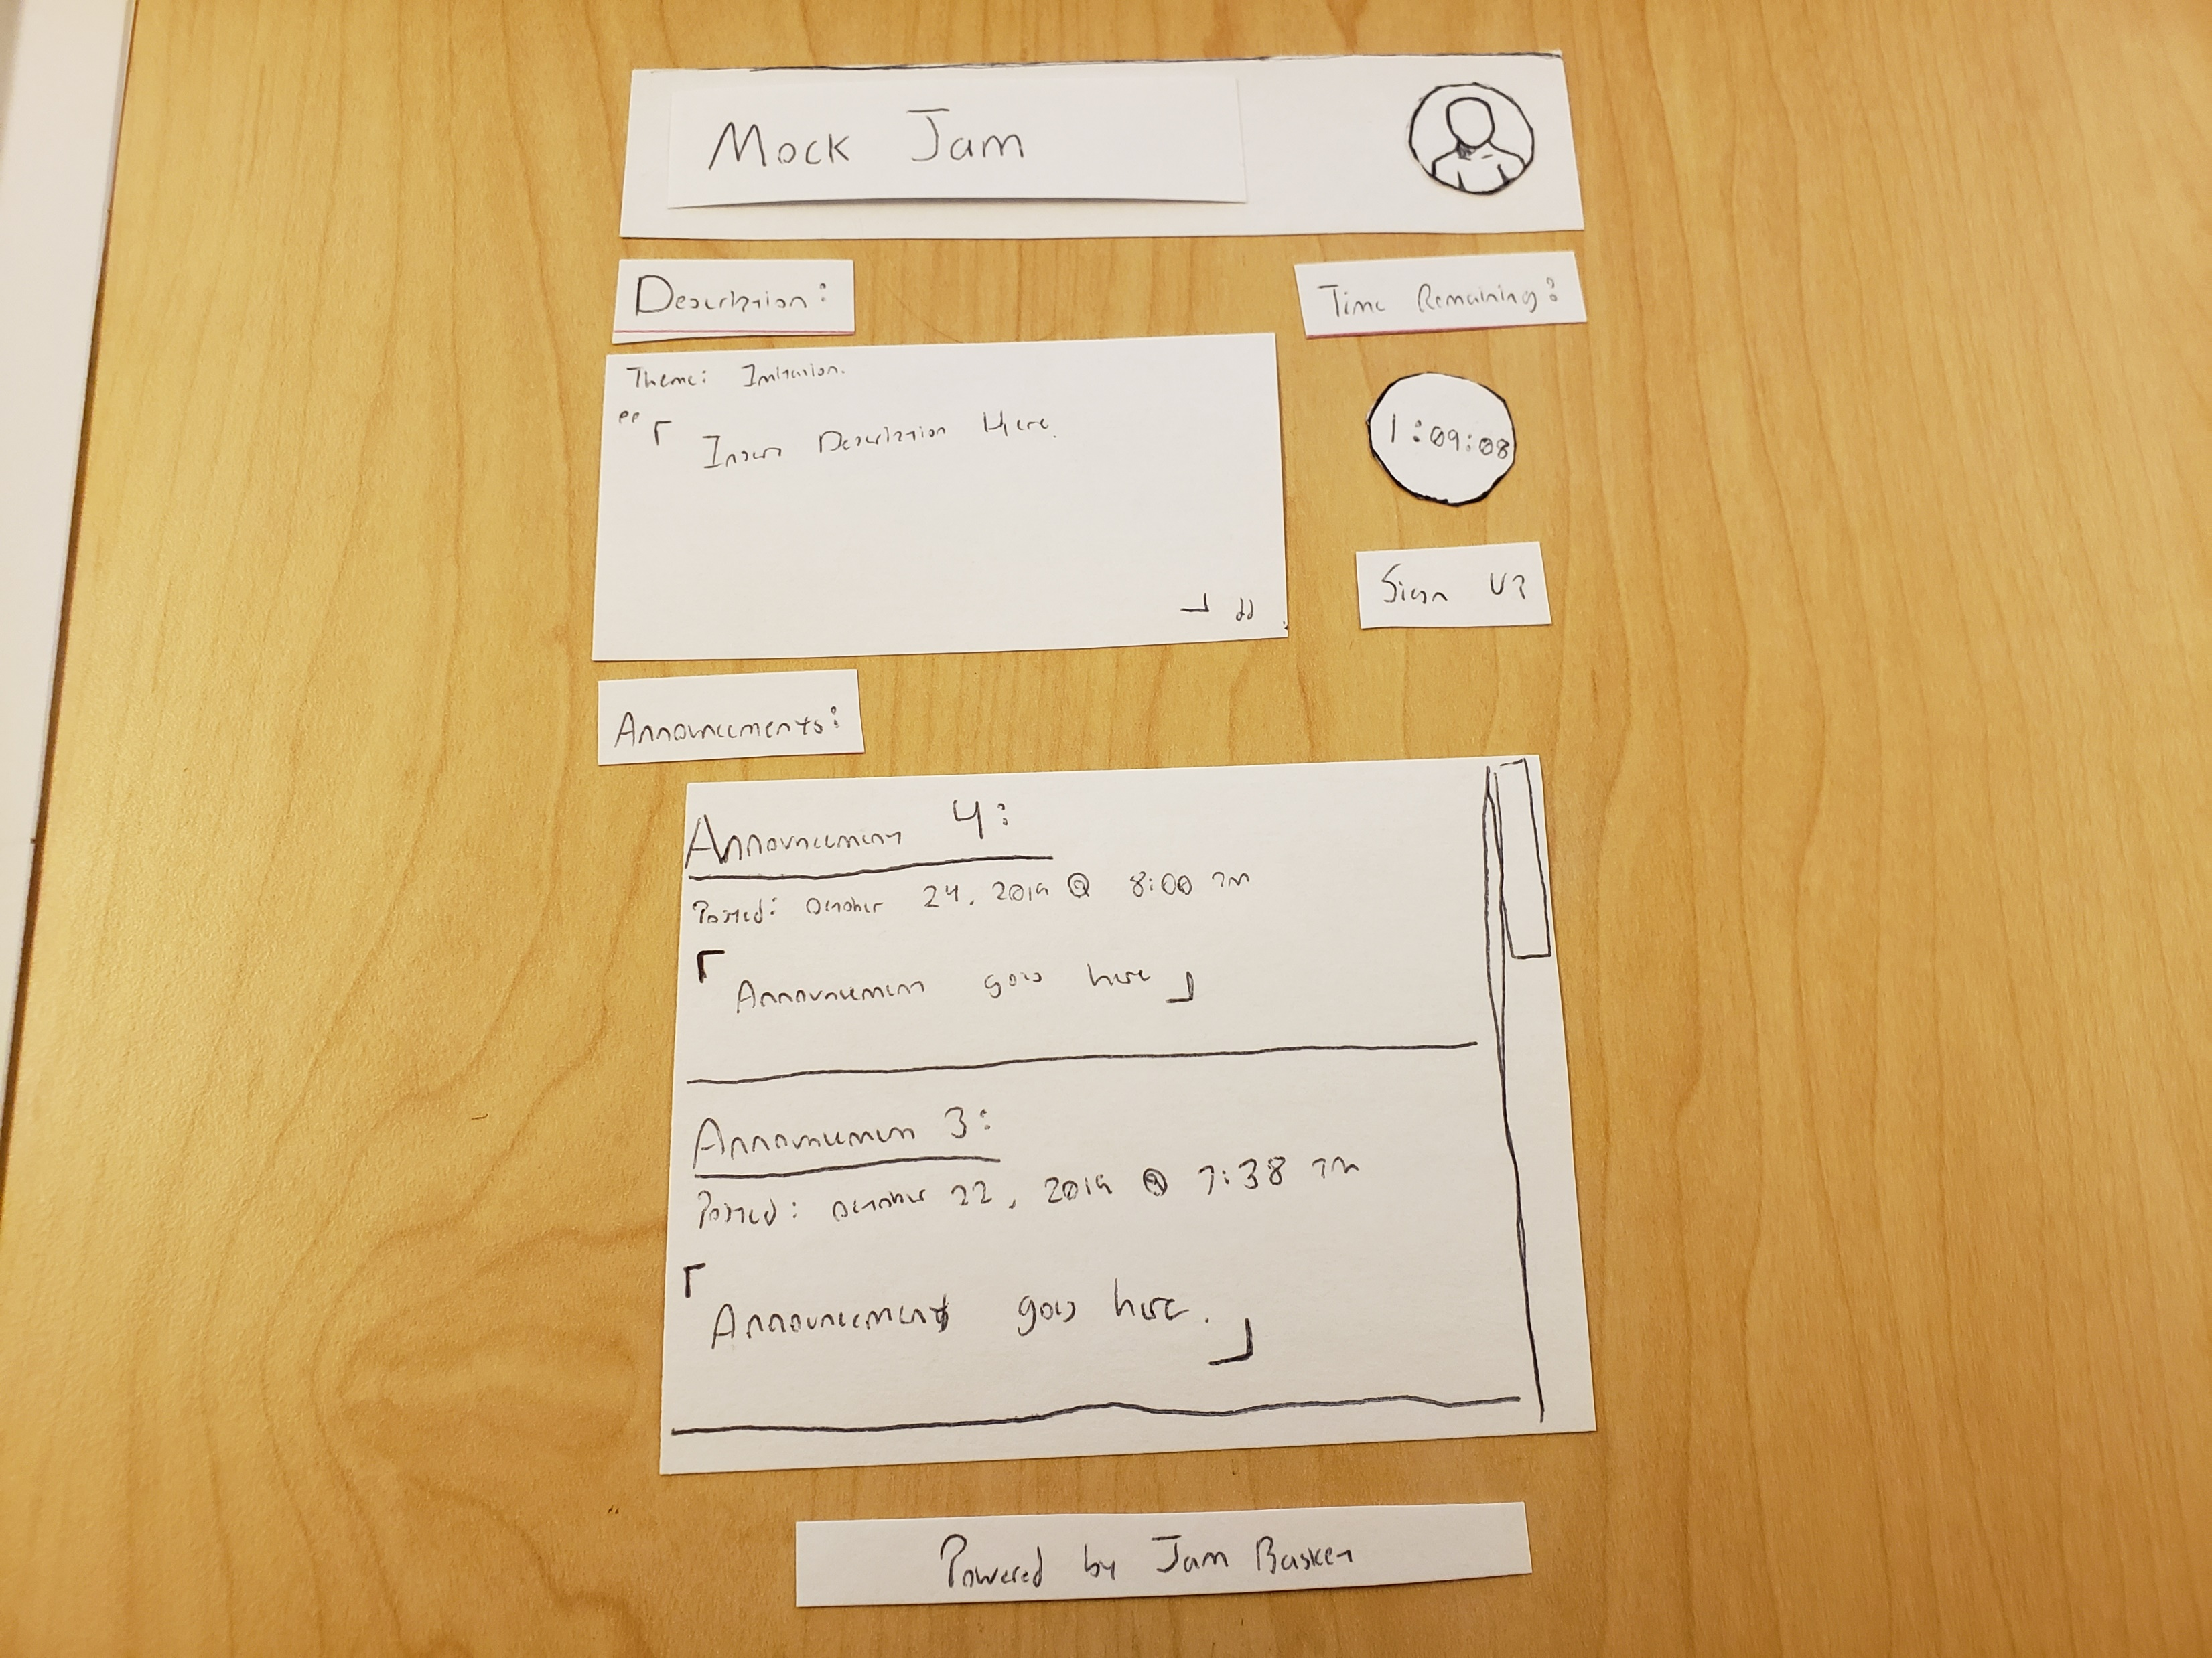

Slide 15
What is Jam Basket today?

Slide 16

POSTMORTEM

Slide 17
Where did we struggle? What did we learn?
We overscoped.
Consider not only what you can do, but what you can do in a limited amount of time. It’s fine to aim high, but you need to be realistic.
We once had a week where nothing was done due to miscommunication.
When establishing objectives and responsibilities, everybody must take care to declare and clarify any assumptions they have made.
We realized that our responsibility structure created severe bottlenecks.
When coding in a group, try and make the objectives asynchronous to minimize bottlenecks: reduce the cases where one person’s tasks require the completion of another person’s task.

Slide 18
Any Questions?

